Slide 1

CSCI 4502/5502
Data Mining - Fall 2023 - Lecture 20
Ravi Starzl, PhD

Slide 2

Data Mining Trends and Research Frontiers
Ravi Starzl, PhD - Data Mining Fall 2023

Slide 3
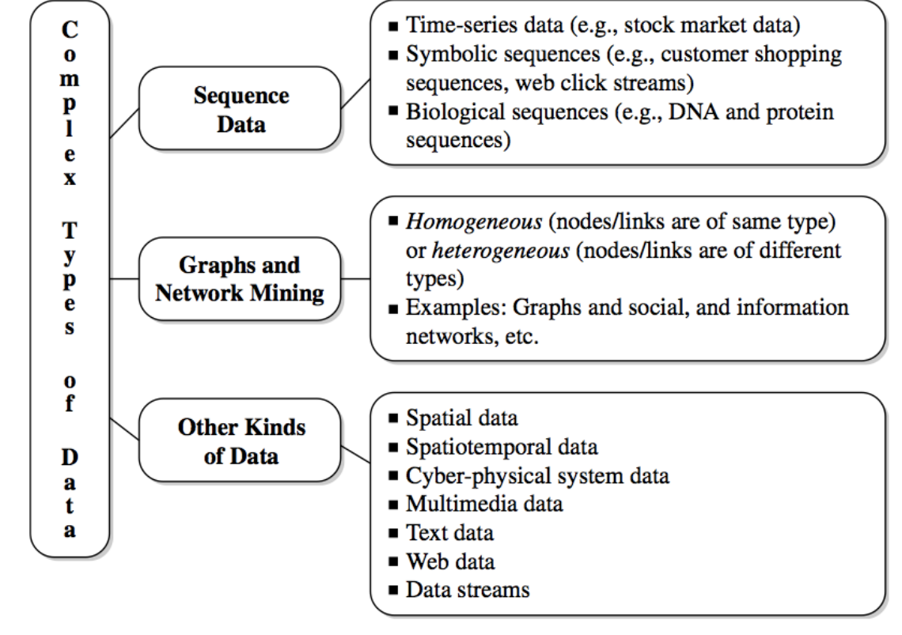
Mining Complex Data Types
Stream data
Sequence data
Graphs and networks
Multimedia, text, Web data
Ravi Starzl, PhD - Data Mining Fall 2023
Notes:
Stream data is continuous, high-volume data that is processed in real-time, often requiring efficient processing methods such as windowing and approximation algorithms. It's common in applications like financial tracking, social media analytics, and sensor networks.
Sequence data represents ordered lists of elements or events, where the order is crucial, as seen in time-series data or biological sequences. Analysis involves sequence alignment, pattern matching, and prediction models, and it's used in genomics, language processing, and predictive analytics.
Graphs and networks represent relationships between entities using nodes and edges, which can be directed or undirected. Analysis methods include graph traversal and network analysis, with applications in social network analysis, route planning, and internet topology research.
Multimedia, text, and web data encompass a variety of formats. Multimedia involves images, video, and audio, requiring feature extraction and machine learning for analysis. Text data uses natural language processing for insights, while web data is analyzed with web scraping, link analysis, and sentiment analysis.
Mining complex data types focuses on extracting information from complex, often unstructured data types. It deals with high dimensionality and heterogeneity, applying advanced algorithms like deep learning, clustering, and anomaly detection. This is crucial in areas like healthcare analytics, customer behavior analysis, and fraud detection.

Slide 4
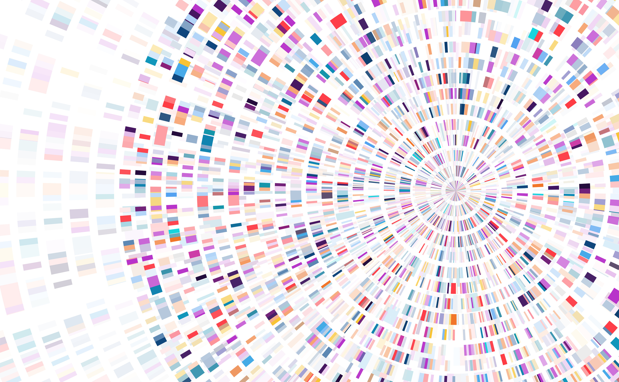
Symbolic Sequence Data
Sequences of ordered elements of events, with or without a notion of time
Frequent patterns: itemsets, sequential, structural
Sequential pattern mining
e.g., first buy digital camera, then color printer, within 3 months
medical treatment, weather prediction, stocks, Web access, etc.
Ravi Starzl, PhD - Data Mining Fall 2023
Notes:
Symbolic sequence data refers to sequences of ordered elements or events, which may or may not be tied to a time element. This type of data can represent a wide range of scenarios, from purchase histories to weather events.
Frequent patterns in this context include itemsets, sequential patterns, and structural patterns. These patterns are identified by analyzing the recurring sequences or structures within the data.
Sequential pattern mining is a key technique used in analyzing symbolic sequence data. It involves identifying common sequences within a data set, such as the pattern of purchasing a digital camera followed by a color printer within a three-month period.
Examples of applications for symbolic sequence data and sequential pattern mining include tracking and analyzing medical treatment plans, predicting weather patterns, understanding stock market trends, and examining Web access patterns.
These analyses help in making informed decisions and predictions, such as understanding consumer behavior, optimizing medical treatments, forecasting weather-related events, or predicting stock market movements based on historical data.

Slide 5
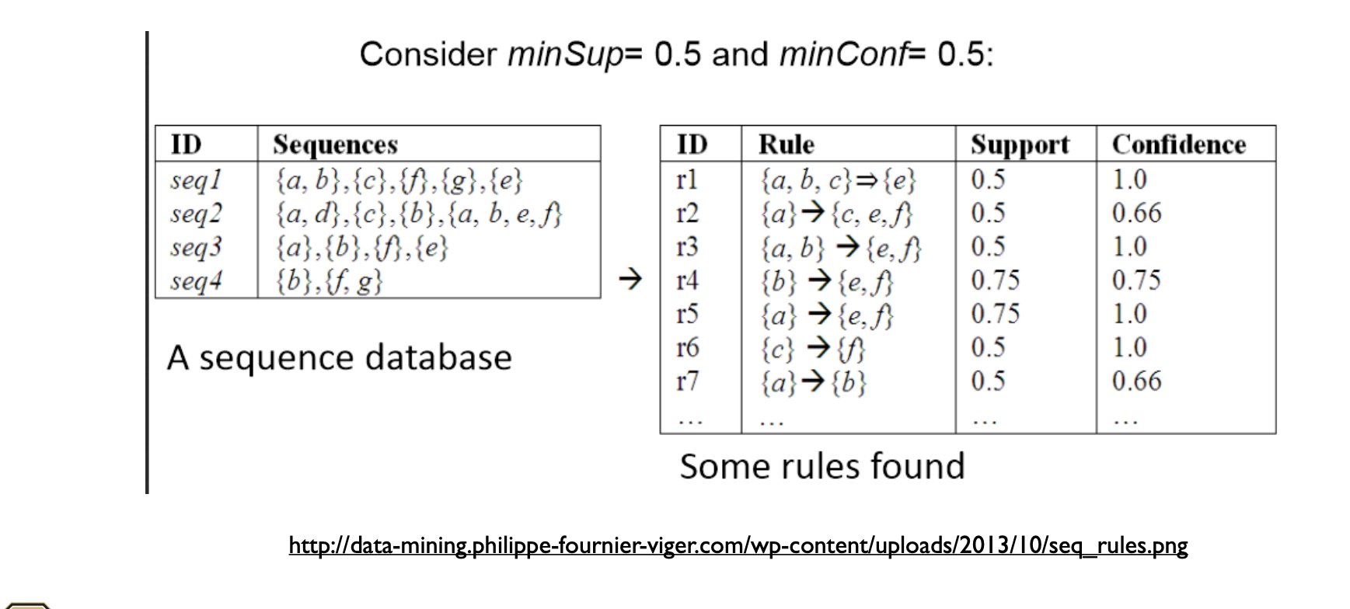
Sequence Mining Example
Ravi Starzl, PhD - Data Mining Fall 2023

Slide 6
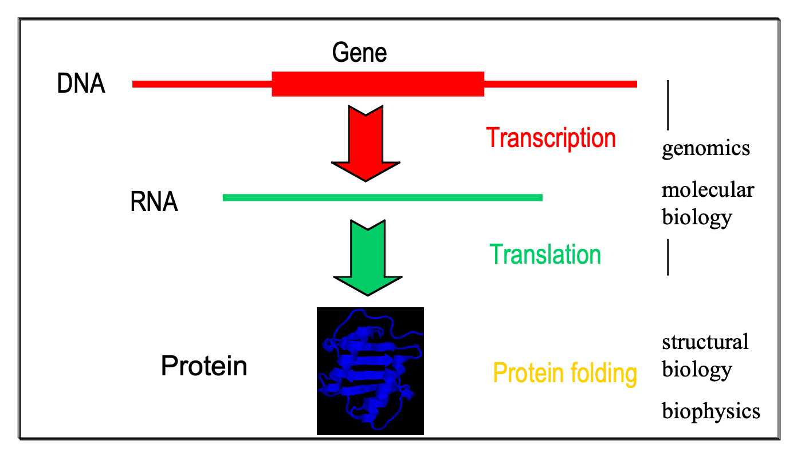
Biological Sequences
Ravi Starzl, PhD - Data Mining Fall 2023
Notes:
Biological sequences are a type of sequence data specifically related to biological entities, such as DNA, RNA, and proteins. These sequences are composed of nucleotides in the case of DNA and RNA, and amino acids for proteins.
The study of biological sequences involves understanding the structure, function, and evolution of these molecules. Techniques such as sequence alignment and phylogenetic analysis are commonly used.
Sequence alignment is crucial for identifying similarities and differences between biological sequences, which can indicate functional, structural, or evolutionary relationships.
Applications of biological sequence analysis are vast, including gene discovery, disease diagnosis, and drug development. For instance, analyzing DNA sequences can help in identifying genetic mutations linked to diseases.
The field also intersects with bioinformatics, where computational tools are used to manage and analyze the vast amounts of biological sequence data generated by modern research methods like genome sequencing.

Slide 7
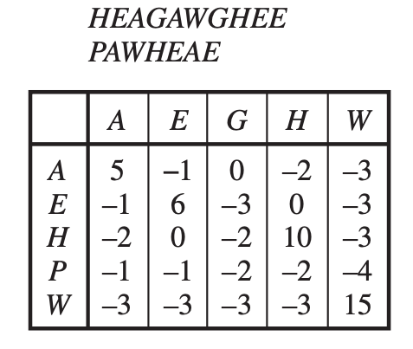
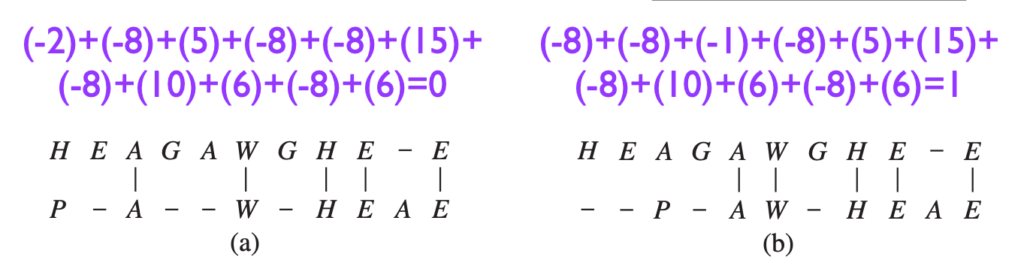
Pairwise Sequence Alignment
Scoring alignments
substitution matrix
gap penalty: -8; gap extension: -8
Ravi Starzl, PhD - Data Mining Fall 2023
Notes:
Pairwise sequence alignment is a computational technique used to align two biological sequences, such as DNA, RNA, or proteins, to identify regions of similarity that may indicate functional, structural, or evolutionary relationships.
Scoring alignments is a critical part of this process, where each alignment is given a score based on how well the sequences match. This scoring helps in determining the optimal alignment between the sequences.
A substitution matrix is used in this process to score replacements of one amino acid or nucleotide with another. Common matrices include PAM and BLOSUM for proteins, and identity matrices for nucleic acids.
Gap penalties are applied to account for insertions or deletions in one of the sequences. A typical gap penalty might be -8 for starting a gap and -8 for extending it. This discourages the creation of gaps in the alignment unless necessary to achieve an optimal alignment.
These techniques are fundamental in bioinformatics and are essential for tasks like identifying conserved sequences, predicting the function of genes or proteins, and understanding evolutionary relationships.

Slide 8
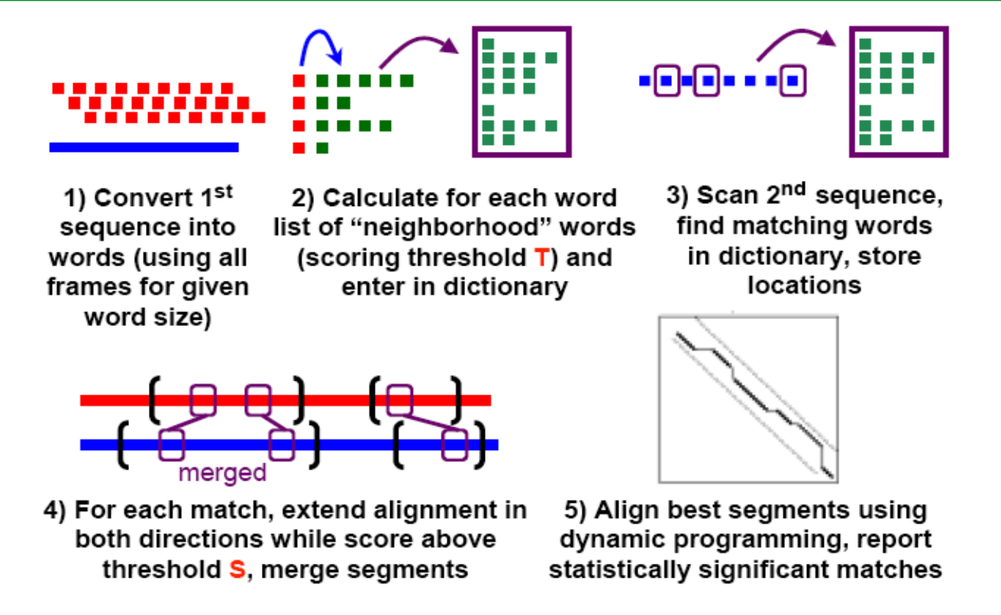
BLAST
Ravi Starzl, PhD - Data Mining Fall 2023
Notes:
BLAST (Basic Local Alignment Search Tool) is a widely-used algorithm for comparing primary biological sequence information, such as amino-acid sequences of proteins or the nucleotides of DNA or RNA sequences.
The main function of BLAST is to find regions of similarity between biological sequences. It compares a query sequence against a database of sequences, quickly identifying matches despite various levels of mutation.
BLAST uses a heuristic method, which means it's designed for speed over perfect accuracy, making it faster than exhaustive search methods like dynamic programming used in pairwise sequence alignment.
The tool provides various versions tailored to different types of sequences and comparison needs, such as BLASTN for nucleotide sequences, BLASTP for protein sequences, and others for more specific applications.
BLAST results include a list of sequence alignments with similarity scores, providing insights into potential functional and evolutionary relationships. These results are crucial for researchers in fields like molecular biology, genetics, and evolutionary biology.

Slide 9
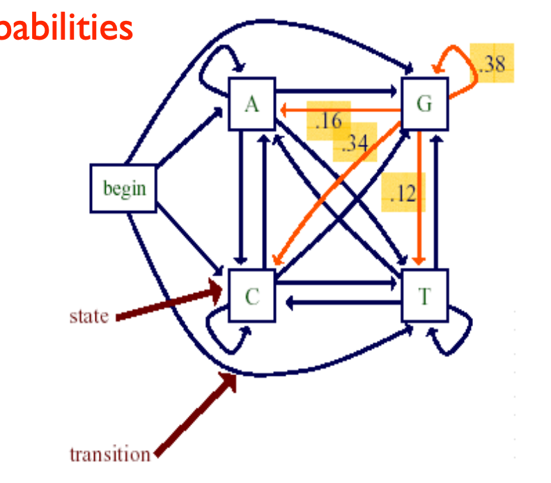
A Markov Chain Model
States, transitions w/ associated probabilities
Transition probabilities
Pr(xi=a|xi-1=g) = 0.16
Pr(xi=c|xi-1=g) = 0.34
Pr(xi=g|xi-1=g) = 0.38
Pr(xi=t|xi-1=g) = 0.12
sum Pr(xi|xi-1=g) = 1 13
Pr(cggt)=Pr(c)Pr(g|c)Pr(g|g)Pr(t|g)
Ravi Starzl, PhD - Data Mining Fall 2023
Notes:
A Markov Chain Model is a stochastic model describing a sequence of possible events, where the probability of each event depends only on the state attained in the previous event. It's a way to model random processes that follow a 'memoryless' property.
In this model, 'states' represent the different possible outcomes at each step, and 'transitions' are the movements from one state to another, with each transition having an associated probability.
Transition probabilities are the core of a Markov Chain, determining the likelihood of moving from one state to another. For example, in a genetic sequence, the probability of a nucleotide being adenine (a), cytosine (c), guanine (g), or thymine (t) after a guanine can be represented with specific probabilities.
The given probabilities like Pr(xi=a|xi-1=g) = 0.16, interpret as the probability of 'a' following 'g' being 16%. Similarly, Pr(xi=c|xi-1=g) = 0.34, and so on, indicate the likelihood of each nucleotide following a guanine.
The sum of these transition probabilities for a given state always equals 1, ensuring that the probabilities are properly normalized and account for all possible outcomes.
The probability of a specific sequence, like 'cggt', can be calculated using the product of the initial probability of the first state and the subsequent transition probabilities. For instance, Pr(cggt) would be computed as Pr(c) × Pr(g|c) × Pr(g|g) × Pr(t|g), combining the initial probability of 'c' with the probabilities of each subsequent nucleotide given the previous one.
Markov Chains are widely used in various fields, including genetics, economics, and computer science, for modeling sequences where the 'memoryless' property is a reasonable assumption.

Slide 10
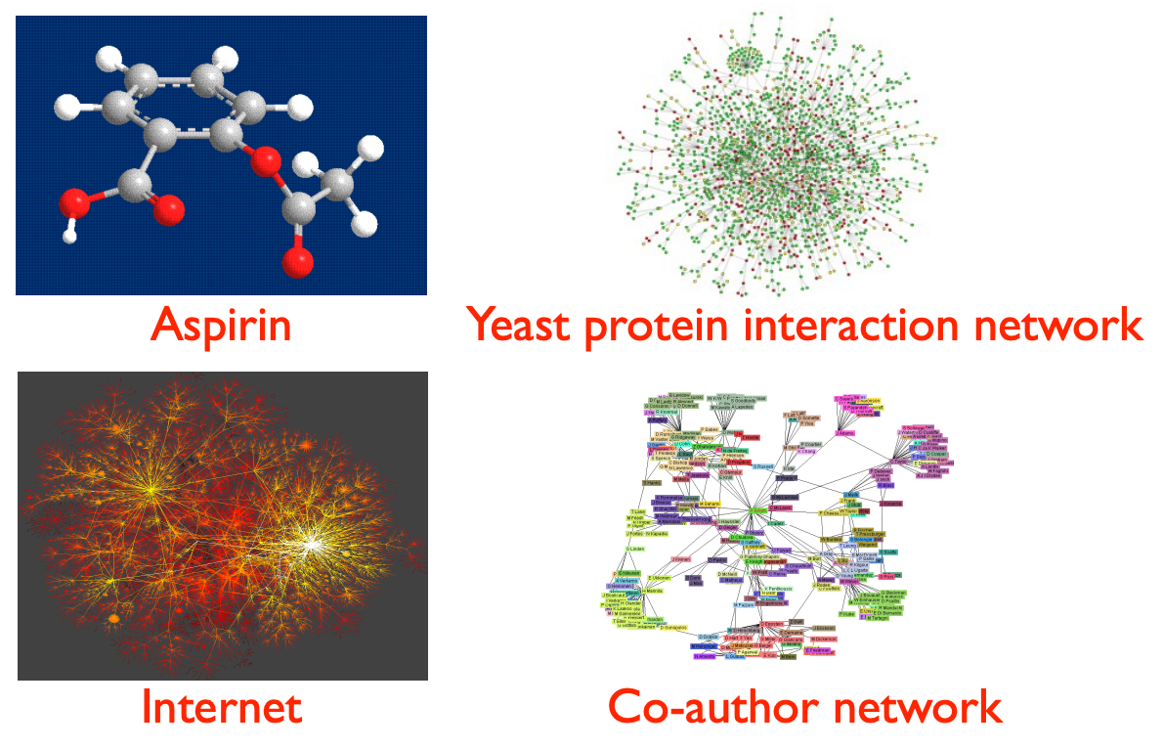
Graph Is Everywhere
Ravi Starzl, PhD - Data Mining Fall 2023
Notes:
"Graph Is Everywhere" encapsulates the idea that graph theory and graph structures can be applied to a wide range of fields and problems. A graph, consisting of nodes (or vertices) and edges connecting them, is a versatile and powerful tool for representing complex relationships and interactions.
In practical terms, this concept is evident in many areas: social networks are graphs where individuals are nodes and their relationships are edges; in biology, graphs can represent networks of interacting genes or proteins; in computer science, graphs are used in algorithms and data structures for tasks like network flow and shortest path problems.
Graphs are instrumental in analyzing connectivity, understanding the structure of the internet, optimizing transportation networks, and even in linguistics for parsing sentence structures.
The power of graph theory lies in its ability to model complex, interconnected systems in a simple yet effective way. This makes it a valuable tool for both theoretical research and practical problem-solving across diverse disciplines.
The ubiquity of graphs in various fields demonstrates their fundamental role in understanding and solving complex problems where relationships and interactions are key components.

Slide 11
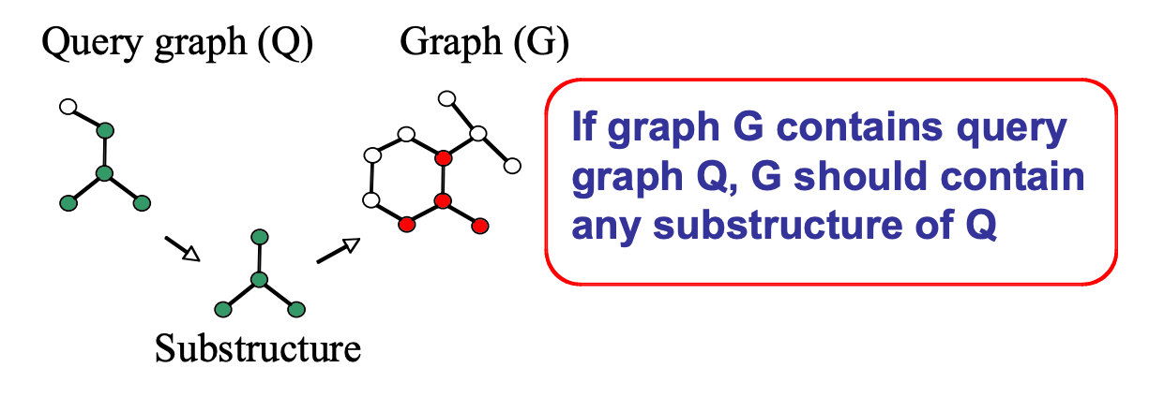
Graph Indexing (1)
Index substructures of a query graph to prune graphs that do not contain these substructures
(1) index construction; (2) query processing
Ravi Starzl, PhD - Data Mining Fall 2023
Notes:
Graph Indexing refers to the process of indexing substructures within a graph to enhance the efficiency of query processing. This technique is particularly useful in large graph databases where direct search can be computationally expensive.
The key idea is to index certain substructures of a graph, such as specific patterns or configurations of nodes and edges. During a query, these indices are used to quickly eliminate graphs that do not contain the queried substructures, significantly reducing the search space and improving query performance.
The process of graph indexing can be broken down into two primary stages:
Index Construction: This is the phase where the graph database is analyzed, and relevant substructures are identified and indexed. The choice of which substructures to index is critical and can depend on the types of queries expected. The indexing must be done in a way that balances the storage overhead with the speed of retrieval.
Query Processing: During this stage, when a query is made against the graph database, the indices are utilized to quickly locate and retrieve graphs or subgraphs that match the query criteria. This step involves checking the indexed substructures against the query graph and pruning away any graphs that don't contain these indexed features.
Graph indexing is an essential technique in various applications where large graph data sets are used, such as social network analysis, bioinformatics, and network security. It facilitates efficient data retrieval and analysis, which is crucial given the size and complexity of the datasets in these domains.

Slide 12

Graph Indexing (2)
Step 1: Index construction
enumerate structures in the graph database, build an inverted index between structures and graphs
Step 2: Query processing
enumerate structures in the query graph
identify candidate graphs
subgraph isomorphism test: prune false positives
Ravi Starzl, PhD - Data Mining Fall 2023
Notes:
Graph Indexing, Step 1: Index Construction
This initial step involves enumerating structures within the graph database. These structures could be specific patterns, configurations of nodes, or particular relationships.
Once these structures are identified, an inverted index is built. This index effectively maps the identified structures to the graphs in which they appear. The purpose of this indexing is to facilitate quick and efficient lookup: given a structure, the index can immediately identify all graphs containing that structure.
The process of building this index is crucial as it lays the foundation for efficient query processing. The choice of structures to index and the method of indexing must balance between the completeness of the database representation and the resource constraints like storage and computational power.
Graph Indexing, Step 2: Query Processing
In this phase, the focus shifts to handling and processing queries against the graph database. The first step is to enumerate structures within the query graph, similar to the process done during index construction.
The next step involves identifying candidate graphs from the database that potentially match the query. This is done using the inverted index created in the first step. The index quickly points to graphs that contain the same structures as those found in the query graph.
The final and critical step is the subgraph isomorphism test. This test is performed to confirm whether the candidate graphs truly contain the query graph as a subgraph. It helps in pruning false positives – those graphs that were initially identified as candidates but, upon closer inspection, do not actually match the query graph's structure.
This step is computationally intensive but is essential for ensuring the accuracy and relevance of the query results.

Slide 13

Social Network Introduction
General properties of social networks
large scale, continual growth
distributed, organic growth: nodes “decide’’ whom to link to
interaction restricted to links
mixture of local and long-distance connections
abstract notion of distance: geographical, content, social, ...
Ravi Starzl, PhD - Data Mining Fall 2023
Notes:
Social Network Introduction
Social networks are a category of networks that specifically represent social interactions and relationships. They have distinct characteristics that set them apart from other types of networks.
General Properties of Social Networks
Large Scale and Continual Growth: Social networks are often vast in size and are continually expanding as new users join and form connections. This continuous growth adds layers of complexity and dynamism to the network.
Distributed and Organic Growth: Unlike centrally organized networks, social networks grow organically. The nodes, representing individuals or entities, autonomously decide whom to connect with, leading to a decentralized and often unpredictable growth pattern.
Interaction Restricted to Links: In social networks, interactions occur along the edges or links of the network. These links represent various forms of social interactions or relationships, like friendships, professional connections, or followings.
Mixture of Local and Long-Distance Connections: Social networks exhibit a mix of local connections (links between physically or contextually close nodes) and long-distance connections, which bridge disparate parts of the network. This blend contributes to the 'small-world' phenomenon often observed in social networks.
Abstract Notion of Distance: Distance in social networks can be understood in multiple dimensions – it's not just geographical but can also be based on content similarity, social context, shared interests, or even ideological alignment. This multifaceted notion of distance influences how connections are formed and maintained.

Slide 14
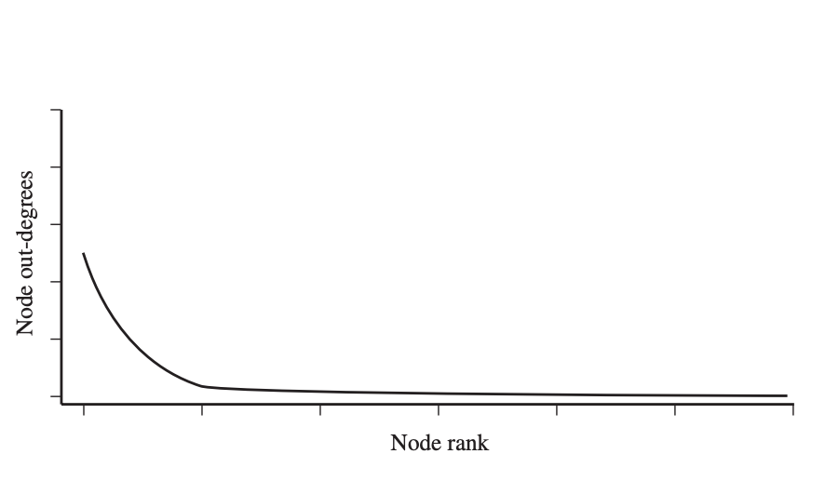
Social Network Introduction
A “canonical” network has
few connected components
small diameter
high degree of clustering
heavy-tailed degree distribution
Ravi Starzl, PhD - Data Mining Fall 2023
Notes:
Social Network Introduction: Characteristics of a "Canonical" Network
A "canonical" social network, often considered a typical or ideal example, exhibits specific properties that are characteristic of many real-world social networks. Understanding these properties is crucial for studying social dynamics, network theory, and their applications.
Few Connected Components: In such networks, there are usually a small number of connected components. A connected component is a subset of nodes in which each pair of nodes is connected by a path. In many social networks, there's often one large connected component, sometimes referred to as the "giant component," where a majority of the nodes are interconnected.
Small Diameter: The diameter of a network is the longest shortest path between any two nodes. Canonical social networks typically have a small diameter, meaning that the longest distance (in terms of steps in the network) between any two nodes is relatively short. This property is related to the concept of "six degrees of separation" and contributes to the 'small-world' phenomenon.
High Degree of Clustering: Clustering in social networks refers to the extent to which nodes tend to cluster together, forming tightly knit groups. A high degree of clustering indicates that friends of a person are likely to be friends with each other as well, forming a close-knit community.
Heavy-Tailed Degree Distribution: This property indicates that while most nodes in the network have a relatively small number of connections, a few nodes (often called "hubs") have a very high number of connections. This distribution is often described by power laws, and it contrasts with random networks where connections are more evenly distributed.

Slide 15

Web Image Representation
Visual features
traditional content-based image retrieval
Textual features
surrounding text in image block
Link graph features
image graph embedding
Ravi Starzl, PhD - Data Mining Fall 2023
Notes:
Web Image Representation
Web image representation involves various techniques and features to effectively describe and manage images on the web. This encompasses not just the visual content of the images themselves, but also the contextual and relational data associated with them. Here's a breakdown of the key features:
Visual Features:
These are the primary attributes derived directly from the image content.
In traditional content-based image retrieval (CBIR) systems, visual features such as color histograms, texture patterns, and shape descriptors are used to index and retrieve images based on visual similarity.
These features allow for the analysis and comparison of images based on their inherent visual properties, independent of any external context.
Textual Features:
Textual features refer to the text that accompanies an image on a webpage. This could be the caption, alt text, surrounding paragraphs, or even metadata.
The surrounding text in an image block provides context that can be crucial for understanding the image's content and relevance, especially in web searches where textual cues are used to infer the subject matter of an image.
Analyzing textual features involves natural language processing techniques to extract and interpret the meaning and relevance of the words associated with the images.
Link Graph Features:
This aspect takes into account the hyperlinked structure of the web, where images are not only standalone entities but also part of a larger web of connections.
Image graph embedding involves representing images as nodes in a graph, where edges represent links or relationships (like hyperlinks or contextual relevance) between different images or between images and webpages.
This approach enables the analysis of images in the context of the broader web ecosystem, considering how images are interconnected and how those connections contribute to their meaning and importance.

Slide 16
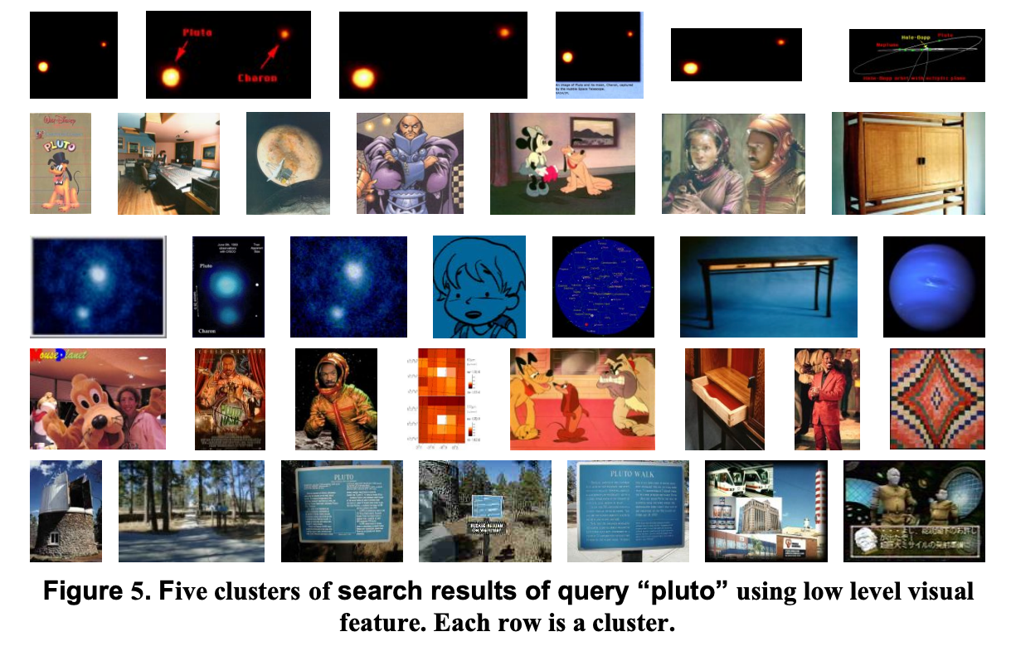
Clustering w/ Visual Features
Similar in color & texture, not in semantic
Ravi Starzl, PhD - Data Mining Fall 2023
Notes:
Clustering with Visual Features
Clustering based on visual features focuses on grouping images together based on their visual similarity, particularly in terms of color and texture, rather than their semantic content or meaning. This approach is particularly relevant in fields like image processing, computer vision, and digital library organization.
Color Features:
Color is one of the most prominent and easily discernible features in an image.
Clustering with color involves analyzing the color distribution within images, using metrics like color histograms, color moments, or color coherence vectors.
The goal is to group images that share similar color patterns or palettes, regardless of what the images actually depict.
Texture Features:
Texture refers to the visual patterns in an image, like smoothness, roughness, or regularity.
Techniques for texture analysis include using filters (like Gabor filters), texture descriptors (like Local Binary Patterns), or statistical methods to capture the texture characteristics.
Clustering based on texture groups images that have similar texture properties, which is useful in differentiating between images with similar colors but different visual patterns.
Non-Semantic Clustering:
The key aspect of this clustering approach is its focus on non-semantic characteristics. That means the actual content or subject matter of the images is not considered in the clustering process.
For example, an image of a blue sky and an image of a blue car might be grouped together if the clustering is solely based on the color blue, despite their different subjects.
Applications:
This method is particularly useful in situations where the subject matter of images is diverse or unknown, and the goal is to organize or search images based on visual style or aesthetics.
It's also used in digital art collections, fashion, design archives, and other domains where visual appearance is a primary factor.

Slide 17
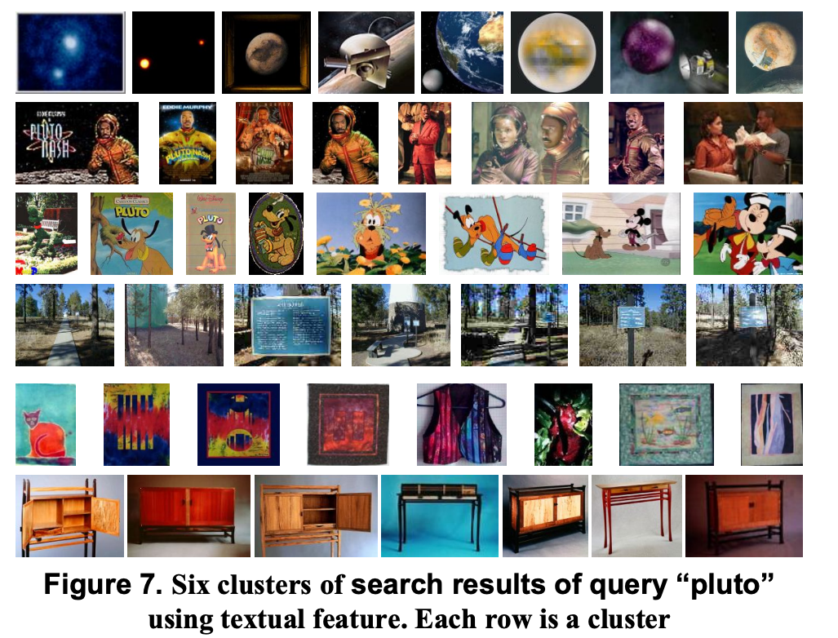
Clustering w/ Textual Feature
Correctly identified 6 semantic clusters
Notes:
Clustering with Textual Features
Clustering using textual features involves grouping together items (such as documents, web pages, or images with accompanying text) based on the similarity of their textual content. This approach is especially useful when the semantic content or meaning of the items is the primary focus. Here's an overview in the context of successfully identifying six semantic clusters:
Semantic Clustering:
In semantic clustering, the focus is on the meaning and topics present in the text, rather than just the presence of specific words or phrases.
This approach often involves natural language processing (NLP) techniques to understand and extract the underlying themes and ideas in the text.
Techniques Used:
Methods like TF-IDF (Term Frequency-Inverse Document Frequency), topic modeling (e.g., Latent Dirichlet Allocation), and word embeddings (e.g., Word2Vec) are commonly used to convert text into a format suitable for clustering.
These techniques help in capturing not just the frequency of words but also the context and relationships between them, leading to more meaningful clusters.
Identifying Six Semantic Clusters:
In a successful application, the algorithm would group the items into six distinct clusters, each representing a unique semantic theme or topic.
For example, in a dataset of news articles, the clusters might represent categories like sports, politics, entertainment, technology, health, and business, each containing articles relevant to those topics.
Evaluation and Validation:
The quality of clustering can be evaluated using metrics like silhouette score, purity, or entropy. These metrics assess how well the items in each cluster are related to each other and how distinct the clusters are from one another.
Additionally, human evaluation or cross-referencing with known categorizations (if available) can be used for validation.
Applications:
Textual feature clustering is widely used in information retrieval systems, document categorization, recommendation systems, and content analysis. It helps in organizing large sets of textual data into manageable and meaningful categories.

Slide 18
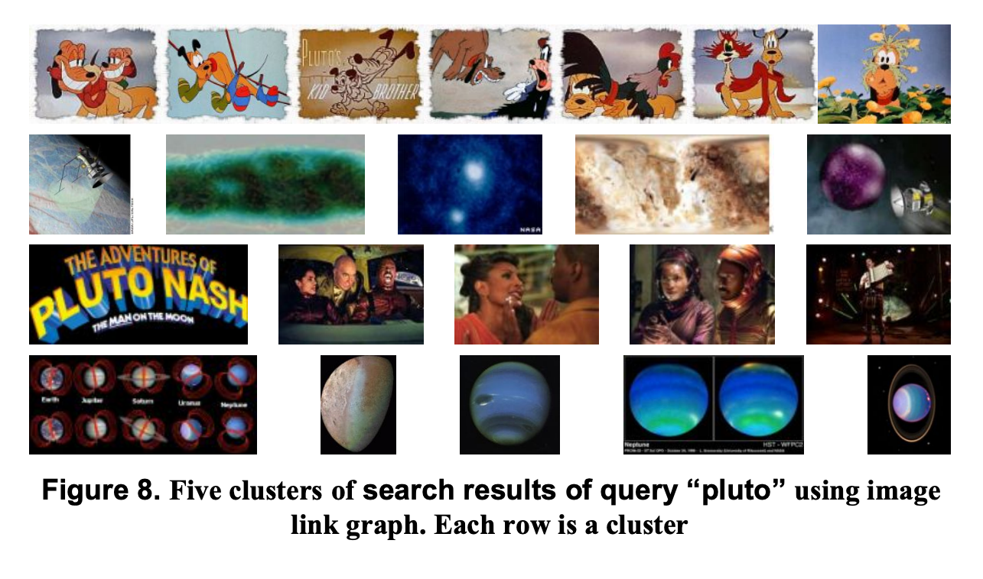
Link Graph Based Clustering
Clusters are semantically aggregated
But too many clusters
Notes:
Link Graph Based Clustering with Semantic Aggregation
Link graph-based clustering, combined with semantic aggregation, is a sophisticated approach that not only considers the content of individual items but also the relationships or links between them. This method is particularly relevant in networked data like web pages, social media posts, or academic papers, where both the content and the connections are significant.
Semantic Aggregation in Clusters:
Semantic aggregation involves grouping items based on their meaning or thematic content. However, when there are too many clusters, it can become challenging to navigate or extract useful insights.
Reducing the number of clusters without losing significant information involves merging smaller, closely related clusters or redefining the criteria for clustering to emphasize broader themes.
Link Graph-Based Approach:
In link graph-based clustering, the focus shifts to how items are interconnected. Each item (like a webpage or document) is a node in the graph, and the links (such as hyperlinks or citations) between them are the edges.
This method helps in identifying not just content-based clusters but also contextual relationships, like which items are frequently referenced together or fall within the same network of interactions.
Combining Both Methods:
Integrating semantic aggregation with link graph-based clustering can lead to more coherent and manageable clusters. It allows for capturing the nuances of content (semantic aspect) and the structure of the network (link graph aspect).
This combined approach can reveal more insightful clusters that are not just thematically consistent but also contextually relevant.
Challenges and Solutions:
One of the challenges in this approach is balancing between the content-based and link-based aspects to avoid overemphasizing one over the other.
Techniques like graph algorithms for community detection (e.g., modularity optimization) or machine learning methods (e.g., neural network embeddings) can be employed to effectively merge these aspects.
Applications:
Useful in various domains like social network analysis, web search optimization, and academic research, where understanding both the content and context of the connections is crucial.

Slide 19
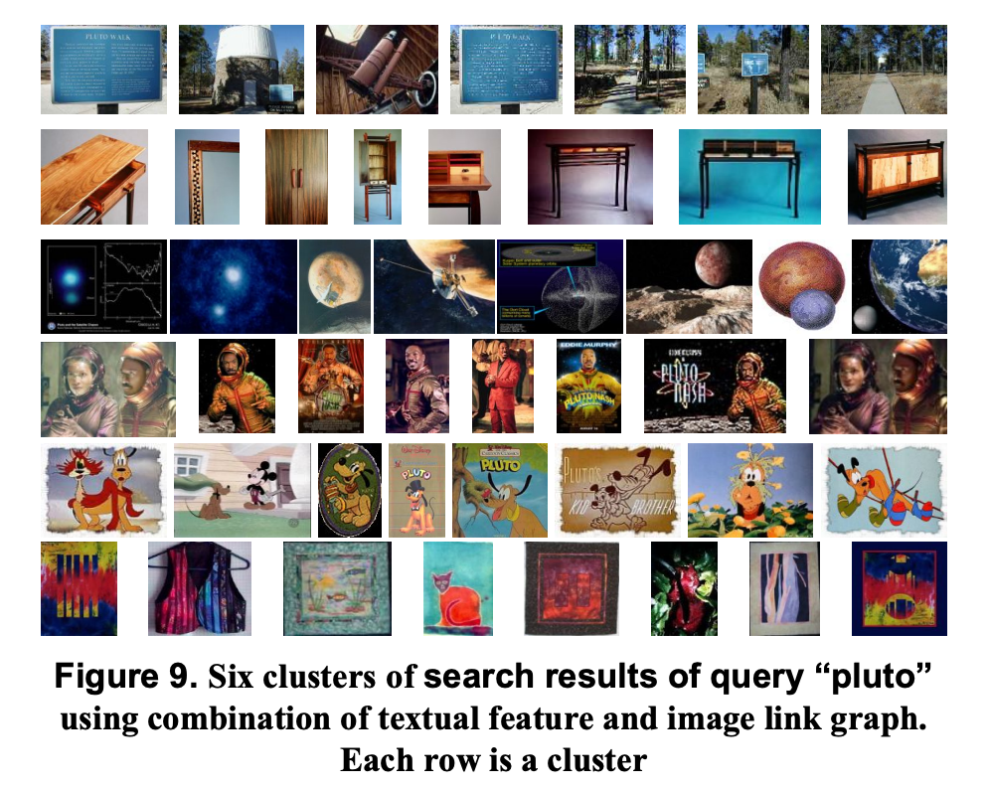
Textual + Link Graph Feature
Notes:
Textual + Link Graph Feature Clustering
Combining textual and link graph features for clustering involves a dual approach that takes into account both the content of the items (textual features) and their relational context within a network (link graph features). This method is particularly effective in analyzing complex data sets where both the content and the structure of relationships are key to understanding the overall picture.
Textual Features:
Textual features involve analyzing the content of documents, web pages, or other text-based items. This includes examining words, phrases, and the overall semantic content using natural language processing (NLP) techniques.
Techniques like TF-IDF, topic modeling, or word embeddings are used to quantify textual data, making it suitable for computational analysis and clustering.
Link Graph Features:
Link graph features consider the relationships or connections between different items. In the context of web pages, these could be hyperlinks; in academic literature, citations; and in social media, shares or likes.
Analyzing link graph features involves using graph theory techniques to understand how items are interconnected and the structure of these networks.
Combining Textual and Link Graph Features:
The integration of these two types of features allows for a more nuanced and comprehensive form of clustering.
While textual analysis provides insights into the content and thematic similarities, the link graph analysis reveals how items are contextually related or influential within the network.
This combined approach can lead to the discovery of clusters that are not only similar in content but also play similar roles or hold similar positions in the overall network.
Applications:
Such a method is highly valuable in web content analysis, social media analytics, academic research, and any field where understanding the interplay between content and context is crucial.
For example, in academic research, this approach could identify clusters of papers that are not only thematically related but also frequently cited together, indicating a specific research trend or community.
Challenges and Solutions:
One of the main challenges is effectively integrating and balancing these two types of features. Techniques like multi-dimensional scaling or advanced machine learning models can be employed for this purpose.
Ensuring the scalability of the method to handle large datasets is also crucial, requiring efficient algorithms and possibly parallel processing.

Slide 20
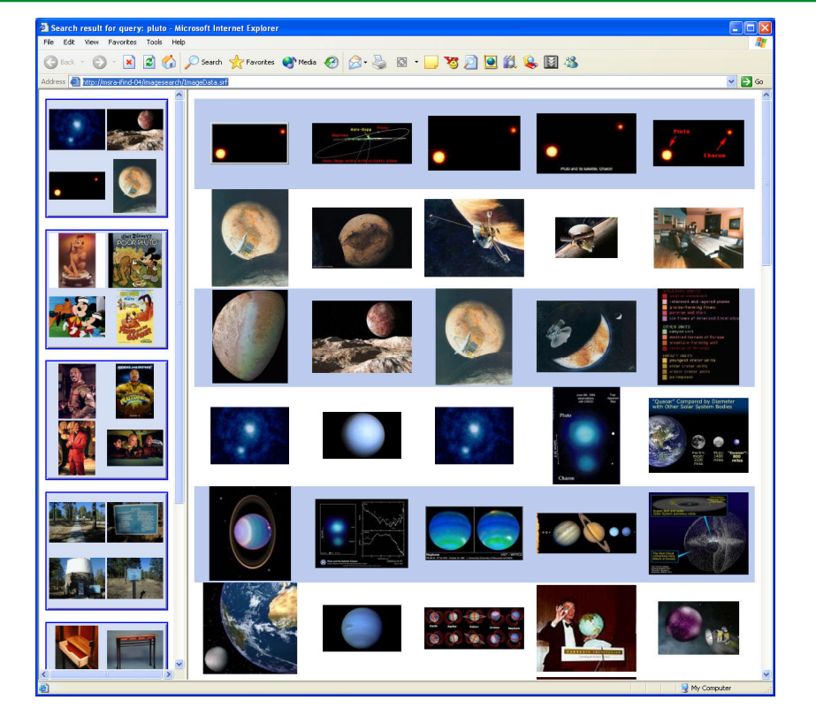
Final Results
Textual + link graph => semantic clusters
Use visual feature to reorganize within each cluster
Notes:
Final Results: Integrating Textual, Link Graph, and Visual Features for Clustering
The final clustering approach integrates textual and link graph features to initially form semantic clusters, and then employs visual features for further reorganization within each cluster. This multi-layered strategy leverages the strengths of each feature type to create a sophisticated and nuanced clustering result.
Stage 1: Forming Semantic Clusters with Textual and Link Graph Features:
Initially, textual and link graph features are used to cluster the data. This stage focuses on the semantic content and the relational context.
Textual analysis, through NLP techniques, groups items based on thematic similarity, while link graph analysis identifies clusters based on how items are interconnected within a network.
The result of this stage is a set of semantic clusters where items are not only topically related but also hold similar roles or positions in their respective networks.
Stage 2: Reorganizing Within Clusters Using Visual Features:
Once semantic clusters are formed, visual features are utilized to further organize items within each cluster. This step focuses on the aesthetic or stylistic aspects of the items.
Visual features such as color, texture, and shape are analyzed to identify subgroups within each semantic cluster. This allows for a finer categorization based on visual similarity.
This stage is particularly valuable when the data set includes a significant visual component, like images or visual content on web pages.
Final Outcome:
The final outcome is a deeply layered clustering structure. The top layer consists of semantic clusters formed based on content and relational context. Within each of these, there are sub-clusters based on visual similarities.
This multi-level clustering approach provides a comprehensive view of the data, capturing the essence of the content, the context of relationships, and the visual characteristics.
Applications:
This method can be particularly effective in fields like digital media analysis, web content categorization, and social media analytics, where understanding the interplay between content, context, and visual presentation is key.
Challenges and Considerations:
Balancing the different feature types to ensure that each contributes meaningfully to the final clustering is essential.
Also, maintaining computational efficiency, especially with large and complex datasets, is a significant consideration.

Slide 21
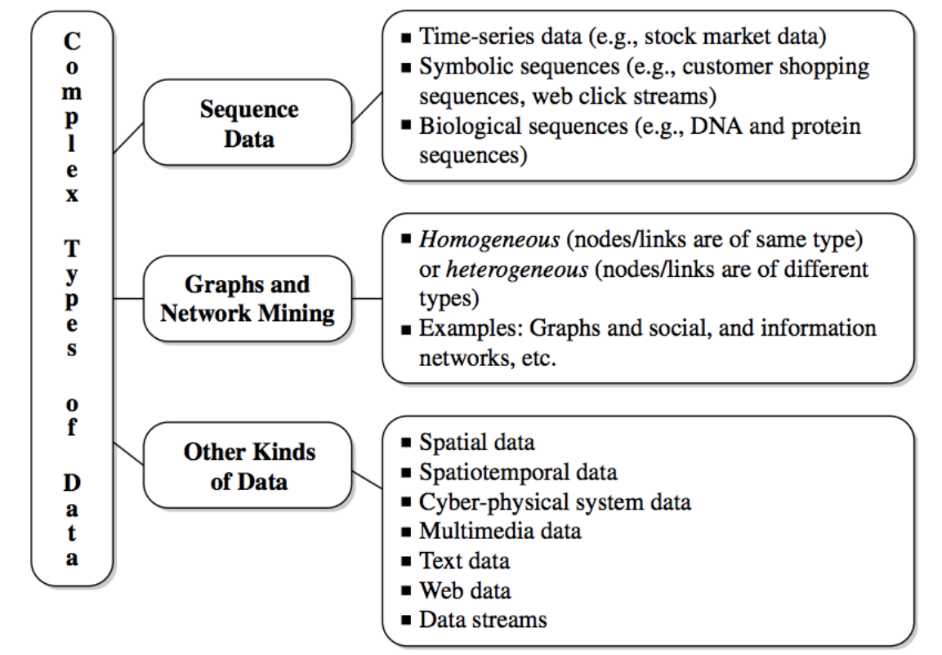
Mining Complex Data Types
Stream data
Sequence data
Graphs and networks
Multimedia, text, Web data
Notes:
Mining Complex Data Types
Mining complex data types involves extracting valuable information and insights from various forms of complex and often unstructured data. This encompasses several distinct types of data, each presenting unique challenges and requiring specialized techniques:
Stream Data:
Stream data refers to continuous, real-time data flows, typically seen in applications like financial market monitoring, social media feeds, and sensor networks.
The key challenges in mining stream data include dealing with its high velocity and volume, and the need for real-time processing and analysis.
Techniques used include windowing (processing data in finite chunks), real-time analytics, and approximation algorithms to handle the constant influx of data.
Sequence Data:
Sequence data consists of ordered elements or events, such as time-series data in economics, DNA sequences in genomics, or user behavior sequences in e-commerce.
The primary challenge here is the analysis of the order and context of elements, which can be crucial for understanding the underlying patterns.
Common methods include sequence alignment, pattern recognition, and time-series analysis to identify trends, predict future events, or understand structural similarities.
Graphs and Networks:
Graphs and networks represent relationships and interactions, used in contexts like social networks, transportation systems, and biological networks.
Challenges involve analyzing the complex web of relationships, including understanding network dynamics, detecting communities or clusters, and identifying influential nodes.
Techniques such as network analysis algorithms, community detection methods, and graph theory are employed to mine and analyze these structures.
Multimedia, Text, and Web Data:
This category includes diverse data types like images, videos, text, and web page content.
The challenges lie in handling the high dimensionality and unstructured nature of such data, and in extracting meaningful patterns from heterogeneous content.
Mining this type of data involves methods like content-based image retrieval, natural language processing, web scraping, and sentiment analysis to derive insights from complex, multi-modal content.

